Slide 1
cost terminologies

Slide 2




THE MARKET SYSTEM AT WORK
The Three Basic Questions...
What, how, & for whom
1. What will be produced?

Slide 3

THE MARKET SYSTEM AT WORK
The Three Basic Questions...
1. What will be produced?
2. How will the goods be produced?

Slide 4

THE MARKET SYSTEM AT WORK
The Three Basic Questions...
1. What will be produced?
2. How will the goods be produced?
3. Who will get the goods & services?

Slide 5

.
Economic Way of Thinking
Do the Benefits outweigh the cost?
Expected marginal benefits
Expected marginal costs

Slide 6
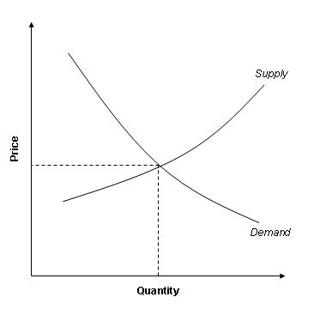
Supply and Demand
Demand
  quantity of a good or service that buyers are willing to purchase at different price points
Supply
  quantity of a good or service that sellers are willing to offer, also at various price points.
    occur within a given market, over a specific period of time.
    market can be defined as “the interaction between potential buyers and potential sellers of a good or service

Slide 7
Demand, Demand Schedule and Curve
Relationship between quantities and prices:
  Demanded at different prices
  Two-dimensional concept
    relationship between the two dimensions of quantity and price being demand
Demand Schedule
  table outlining various price and quantity exist in a specific demand relationship
Demand Curve
  graphical illustration of the points within a
  demand relationship

Slide 8
Supply
Relationship between quantity and price
  a specific amount or quantity
  quantity supplied is the amount of a good or service a supplier is willing to provide at a particular price
  quantity and the correlated price
  detailed through supply schedules and supply curves

Slide 9
Total Product and Average Product
TP
  relationship between a variable input and output
AP
  amount of output produced by each individual unit of the variable input in the production process ____TP___
        AP = #of inputs

Slide 10
Marginal Product
(MFC) Marginal Factor Cost
  additional cost of adding one more unit of variable input to the production process
  To calculate the MFC, divide the change in total cost by the change in number of input units employed
(MVP) Marginal Value Product
  demonstrates the change in total returns received through adding on more unit of input

Slide 11
Three Stages of Production
  Stage I = Increasing marginal returns
  Stage II = Decreasing marginal returns
  Stage III= Negative marginal returns
These can be identified according to the relationship between the TP curve and the MP curve

Slide 12

Principle of Diminishing Returns-Input Basis and Return Scales
The principle of diminishing returns
  relationship among product curves, and assists producers in determining the most effective production level for their operations
  concerned with varying the amount of one input while keeping all other inputs consistent within the production process
  Return Scale
    Increasing returns to scale
    Decreasing returns to scale
    Constant returns to scale
    Producers can use returns-to-scale figures to adjust the amounts of inputs the are employing to make production more efficient—and result in a higher profit

Slide 13
Production Efficiency and The Cost Function
Efficiency is defined as this ratio of output per unit of input
The Cost Function
  Provides valuable information that an
  agribusiness manger needs to determine the level
  of output for profit maximization

Slide 14
Short-Run, Total, and Marginal Cost
Short-run costs:
    illustrates the minimum possible costs of producing at each level of output, when variable factors are used in a cost-minimizing manner
    include total costs, average total costs, and marginal costs
  Total Costs:
    Total cost (TC) includes both fixed and variable costs
    total fixed costs (TFC) are those that do not change according to output
    Total variable costs (TVC) are costs that
    change according to the level of production

Slide 15
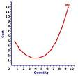
Marginal Costs
Marginal costs:
  (MC) are considered to be the costs of producing each additional unit of output
  Long-Run Average Costs: In contrast to short-run costs (where certain inputs can be considered fixed), in the ling run all costs are considered variable, as the producer can adjust the level of inputs
  The long-run average cost curve allows the producer to choose the optimal level of fixed variable factors of production

Slide 16

The Totals Approach
Total Cost Method:
  The total revenue – total cost approach is based on the fact that total revenue minus total cost equals profit:
TR – TC = Profit

Slide 17

Conclusion
Production economics plays an important role within society
  particularly important to today’s farm managers and producers
Effective farm managers must consider many factors when planning for the success of their agribusiness
Can use the profit maximization framework to determine the profitability of an agribusiness

